Slide 1

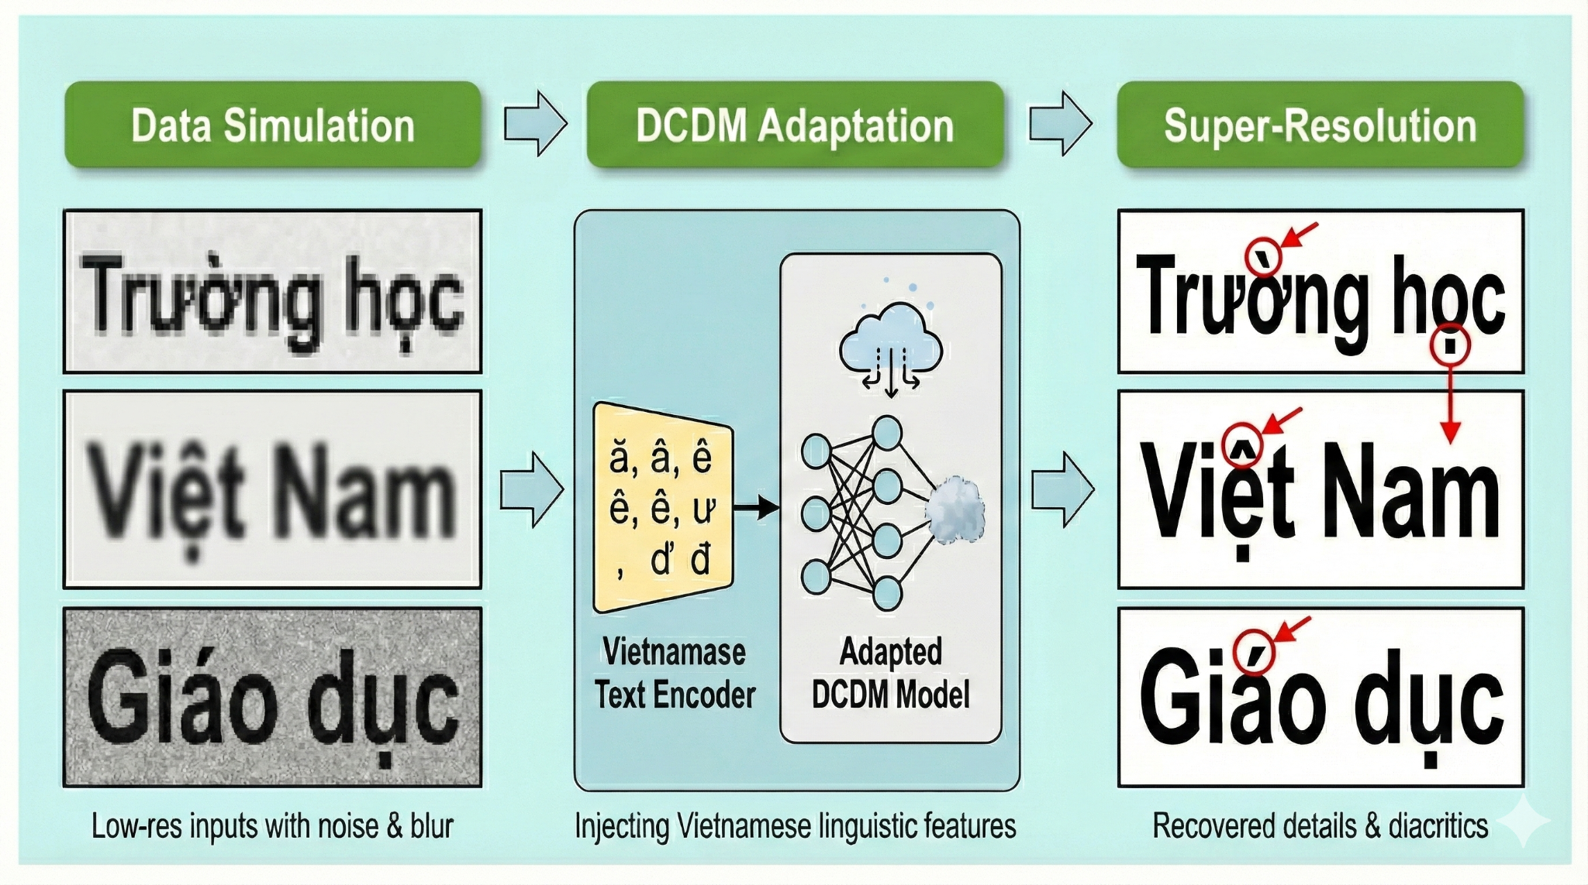

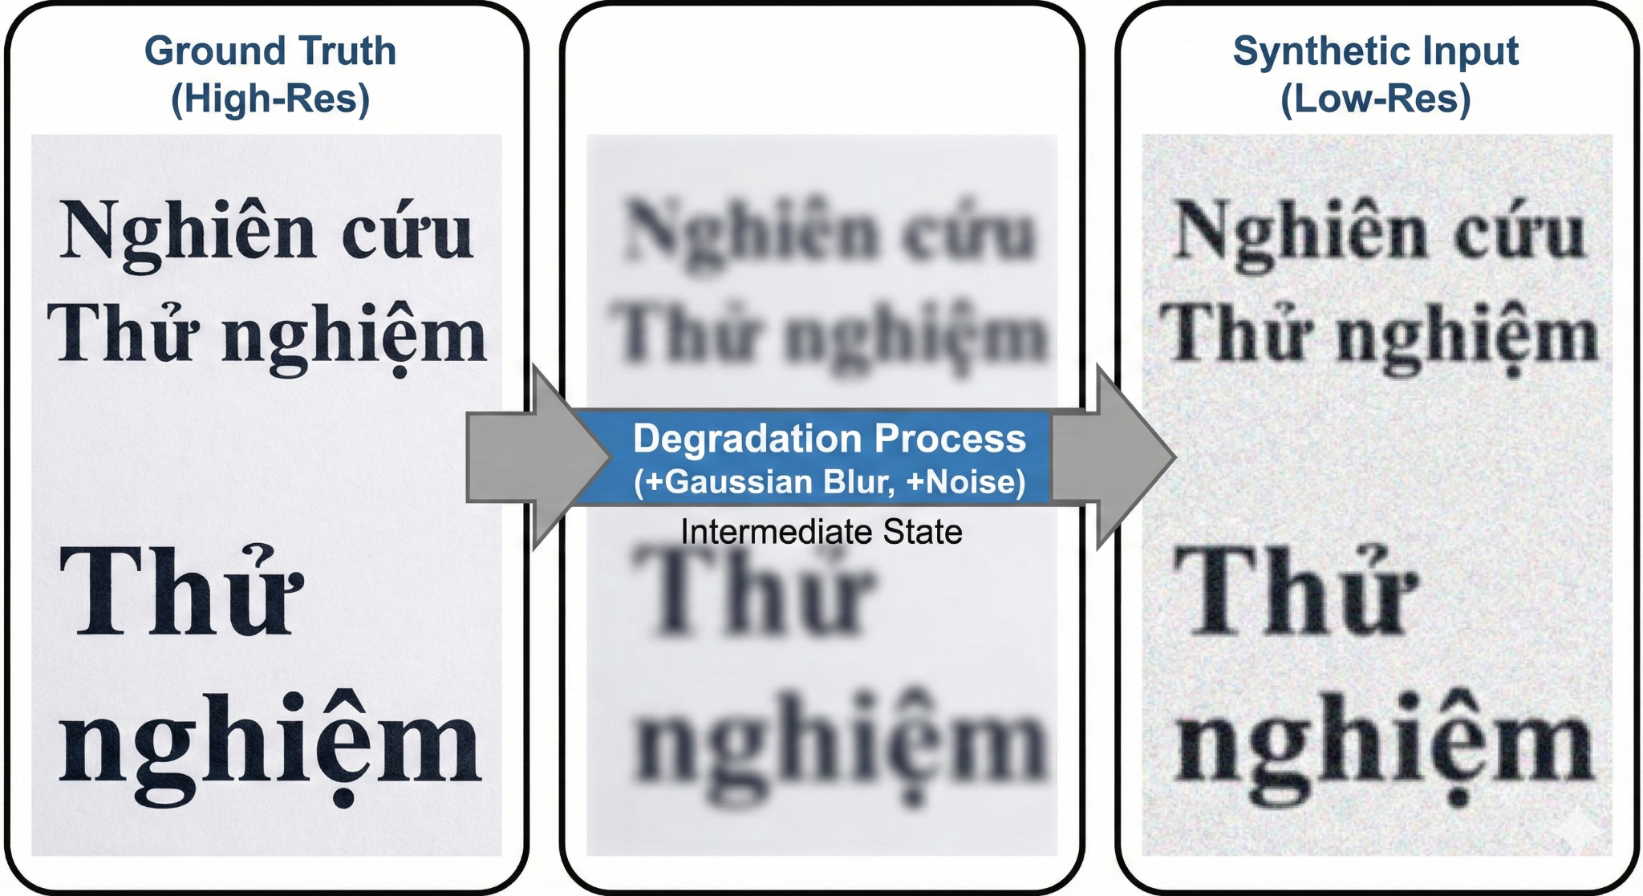
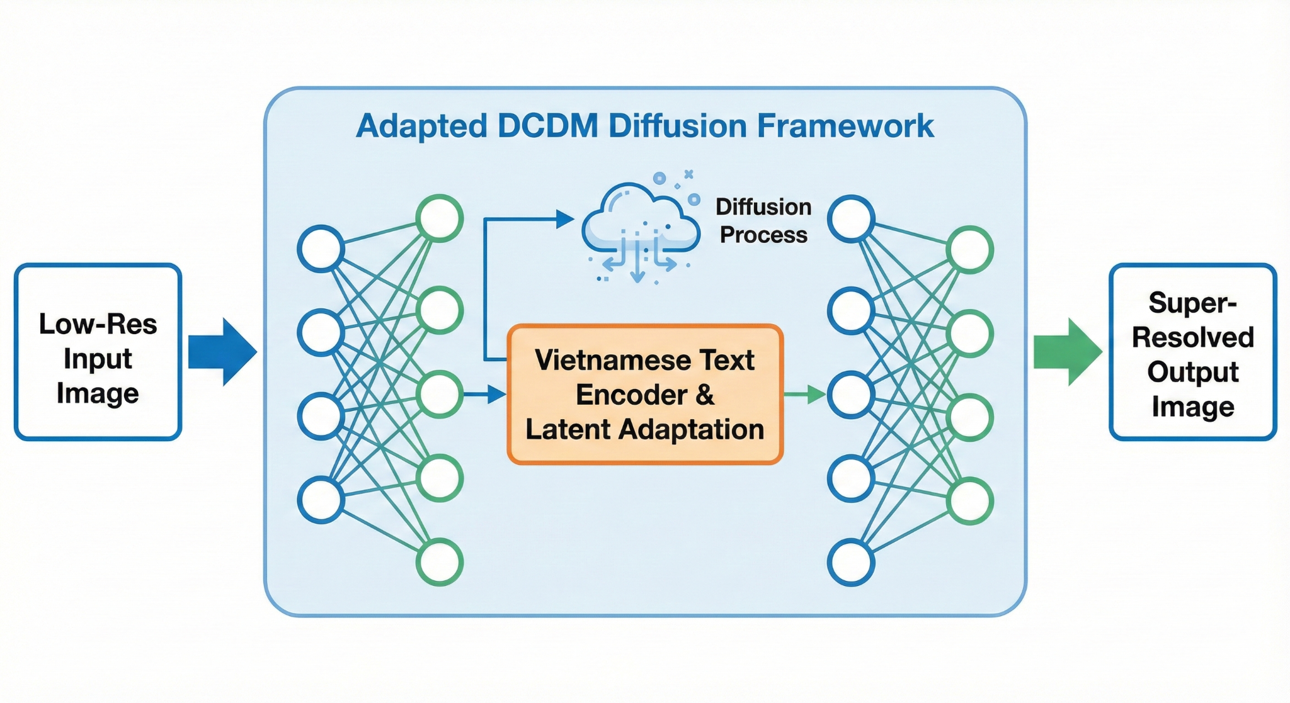
DCDM ADAPTATION FOR VIETNAMESE SCENE TEXT
SUPER-RESOLUTION
Nguyen Hoang Son ^{1,2}
1 University of Information Technology, Ho Chi Minh City, Vietnam
2 Vietnam National University, Ho Chi Minh City, Vietnam
What ?
Why ?
Proposed a solution to adapt the Diffusion-Conditioned Diffusion Model (DCDM) for Vietnamese scene text.
Developed a specialized synthetic dataset containing complex Vietnamese diacritics and tonal marks.
Enhanced the OCR accuracy by preserving the morphological structure of Vietnamese characters during the super-resolution process.
Quality Gap: Real-world scene text is often blurred or low-res, leading to poor OCR performance.
Language Limitation: Current SOTA models like DCDM are designed for English and fail to recognize or recover Vietnamese accents correctly.
Critical Detail: In Vietnamese, a missing or wrong tone mark can change the entire meaning of a word, requiring high-precision recovery.
Overview
●Create pairs of high-resolution and degraded (blurry/noisy) images featuring complex Vietnamese accented characters.
●Expand the model’s character set and fine-tune the architecture to specifically recognize and preserve Vietnamese tonal marks.
●Restore low-quality text images to high-resolution and verify the accuracy through OCR (Optical Character Recognition) performance.
Description
1. Synthetic Dataset Generation
Content: We utilize diverse Unicode fonts and backgrounds to create a rich Vietnamese text corpus.
Degradation: Applied controlled Gaussian blur, motion blur, and down-sampling to simulate real-world environmental noise.
Purpose: To provide a robust training foundation that covers all 89+ unique Vietnamese characters and tone combinations.
2. DCDM Adaptation & Fine-tuning
Latent Expansion: We expanded the character representation space in the latent diffusion module to accommodate Vietnamese-specific glyphs.
Transfer Learning: Initialized weights from the original DCDM and fine-tuned on the Vietnamese dataset to link visual structures with specific semantic tones.
1
0
3. Evaluation Metrics
Visual Quality: Measured via PSNR (Peak Signal-to-Noise Ratio) and SSIM (Structural Similarity Index).
Semantic Accuracy: Evaluated by the Character Error Rate (CER) and Word Error Rate (WER) using popular Vietnamese OCR engines (e.g., Tesseract or VietOCR).
Nguyen Hoang Son – University of Information Technology, Ho Chi Minh City, Vietnam
Email : sonnh.20@grad.uit.edu.vn
Notes:
‹#›

